Slide 1
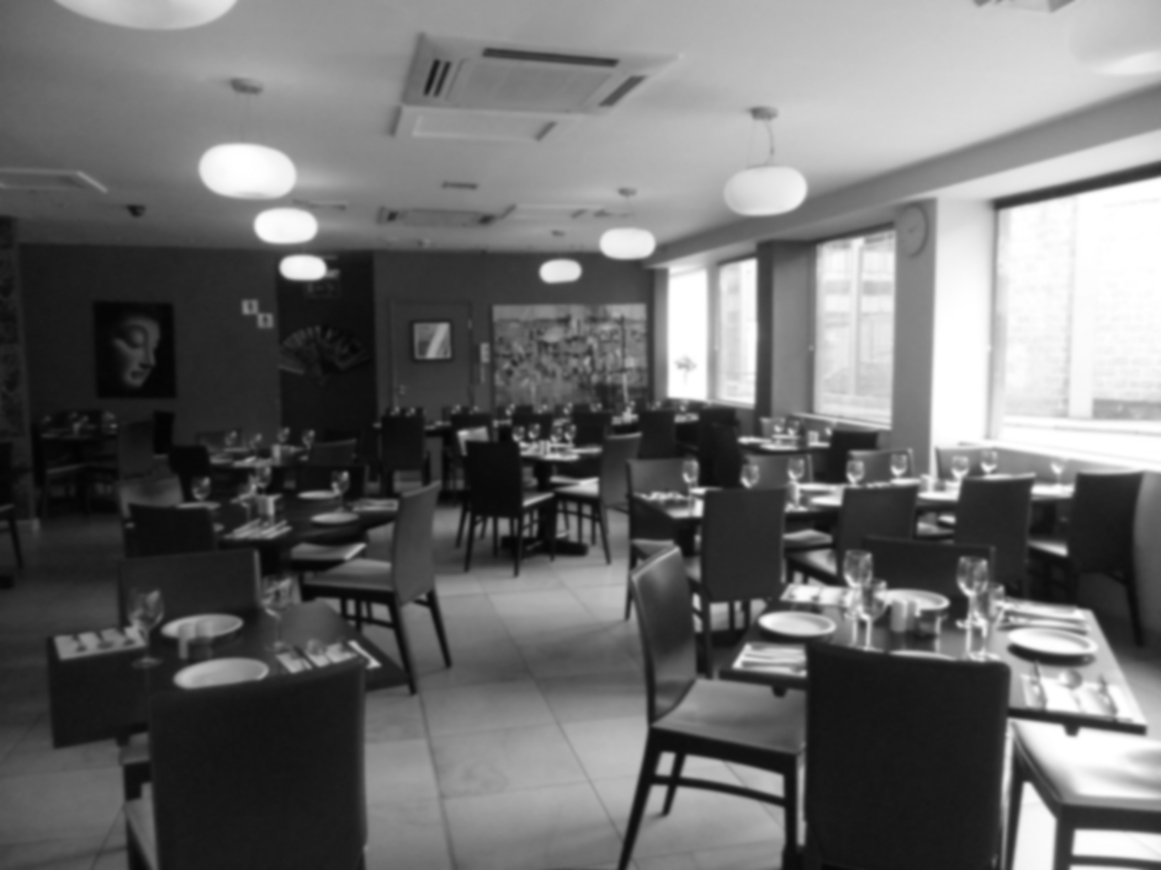
MEMBERS :- GUIDED BY :-
Sagar Jha Aakash Tiwari
Shishir Sharma Upadhyay
Soumya Joshi

Slide 2
WEBSITE DEVELOPMENT
TOPIC :-
Canteen Website

Slide 3
HTML
HTML stands for Hyper Text Markup Language
It is the standard markup language for creating Web pages
It describes the structure of a Web page
It consists of a series of elements
Its elements tell the browser how to display the content
Its elements label pieces of content such as "this is a heading", "this is a paragraph", "this is a link", etc.

Slide 4
JAVASCRIPT
JavaScript, often abbreviated as JS, is a programming language that is one of the core technologies of the Web Development, alongside HTML and CSS.
JavaScript is a text-based programming language used both on the client-side and server-side that allows you to make web pages interactive.
JavaScript is a flexible and powerful programming language that is implemented consistently by various web browsers.
Along with HTML and CSS, it's a core component of web technology. While HTML is responsible for structure and CSS is responsible for style, JavaScript provides interactivity to web pages in the browser.

Slide 5
CSS
Cascading Style Sheets is a style sheet language used for describing the presentation of a document written in a markup language such as HTML.
CSS is a cornerstone technology of the World Wide web, alongside HTML and JavaScript.
CSS is the language for describing the presentation of Web pages, including colors, layout, and fonts.
CSS allows one to adapt the presentation to different types of devices, such as large screens, small screens, or printers. CSS is independent of HTML and can be used with any XML-based markup language.
There are three types of CSS which are Inline CSS, Internal or Embedded CSS and External CSS.

Slide 6
TECHNOLOGY OVERVIEW PLATFORM
Visual Studio is a free source code editor.
Visual Studio is very easy because of following features :-
  Save
  Finding and replacing strings of text with regular expressions.
  Searching text strings within opened tabs.
  Searching text strings in a directory.
  Guided indentation.
  Line bookmarking.
  Line operations, including sorting, case conversion (Uppercase, lowercase, camel case, sentence case), and removal of redundant

Slide 7
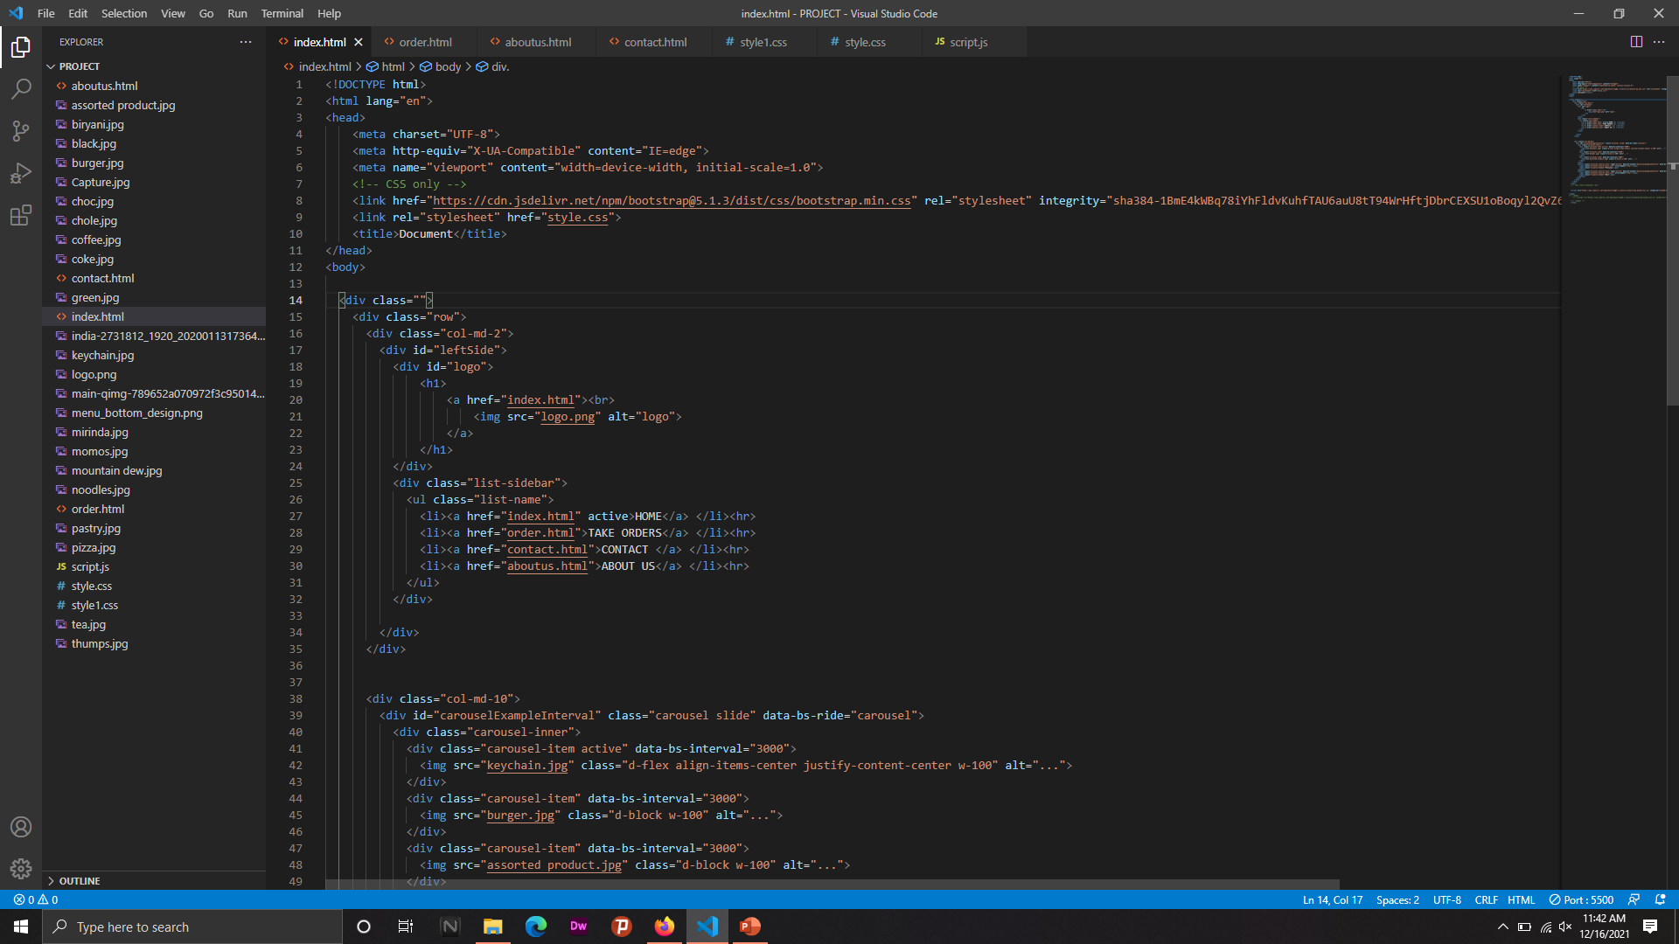

Slide 8
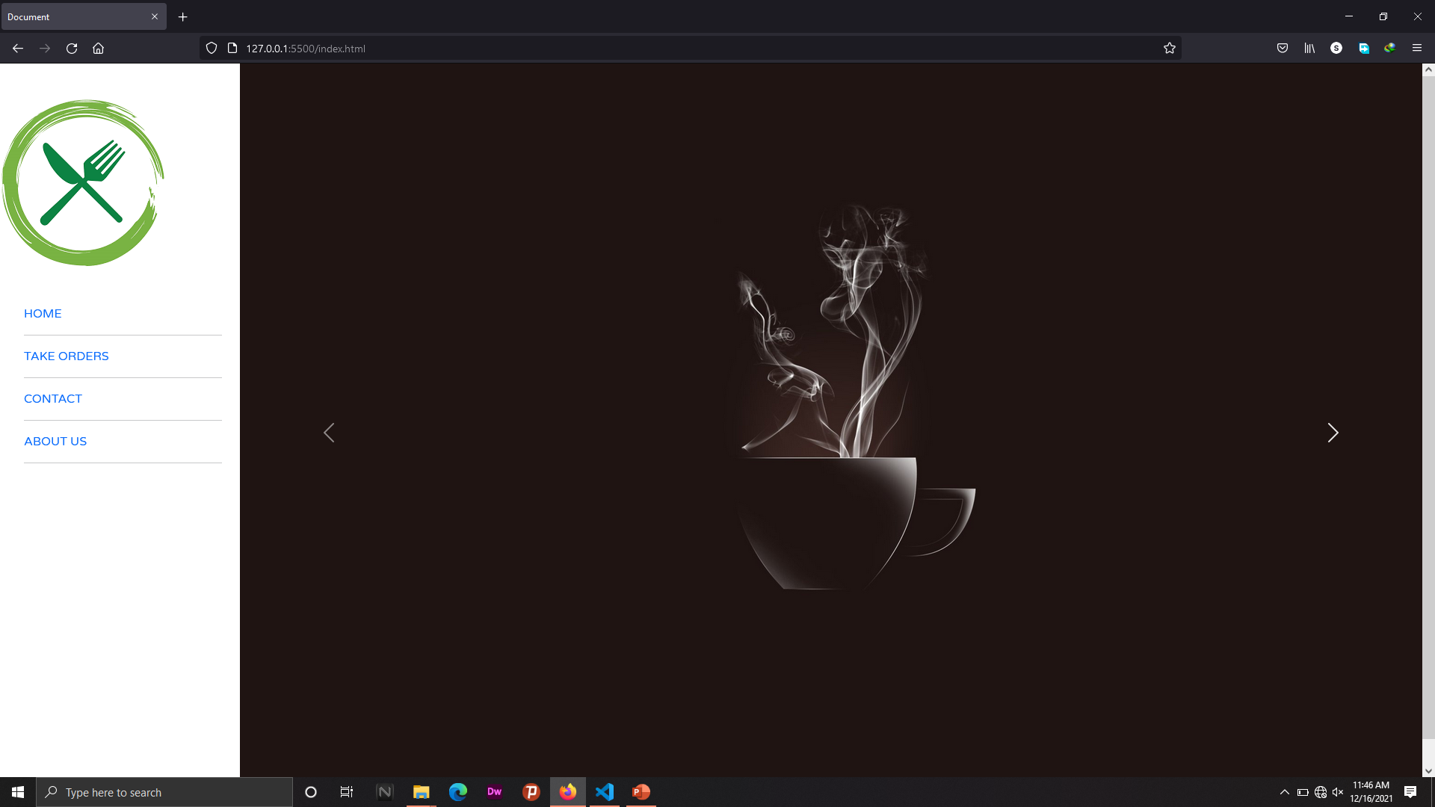

Slide 9
FUTURE IMPROVEMENT
In future we will have bill System.
In future the system will have ordering menu items.
We will make it more user friendly .

Slide 10
DRAWBACKS
Registration for users
Users cannot get their detailed history of their orders.
````````````````````````````````````````````````````````````

Slide 11
CONCLUSION
From this project we have concluded that following canteen website provides menu and contact info. In this online canteen website , the key concept is to provide info about canteen.It can be observed that the information required can be obtain with ease and accuracy on the computerized system. The user with minimum knowledge about computer can be able to operate the canteen website easily. This system also produces a brief result required by the management .

Slide 12
THANK YOU

